Slide 1
Physics of the Wing
airfoils, lift/drag, and more!

Slide 2
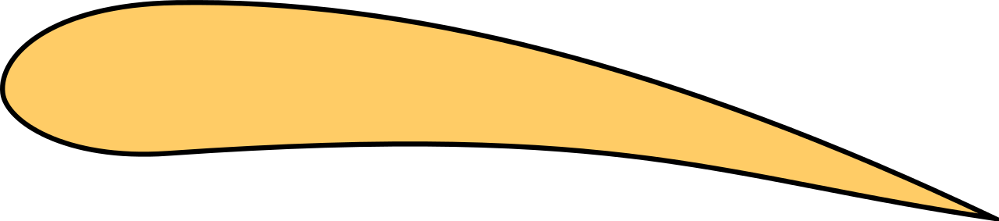

Fun fact! Boats are very similarly shaped to a sideways airfoil because it’s the fastest and most efficient shape for the job
Notes:
agastya

Slide 3
Agenda
20 min — icebreaker + explanation of lift
10 min — further definitions
10 min — explanation of drag
20 min — Airfoil Presentations
Notes:
harish

Slide 4
What is Flight?

Slide 5
Activity!
Breakout rooms
Spend 3 mins researching the physics behind flight and come to a consensus
Room 1
Able to generate lift
Lift → a function of velocity → generated by thrust
Room 2
Need to glide across the air
Room 3
Aerodynamics → lift , drag, weight, thrust
Notes:
maya

Slide 6
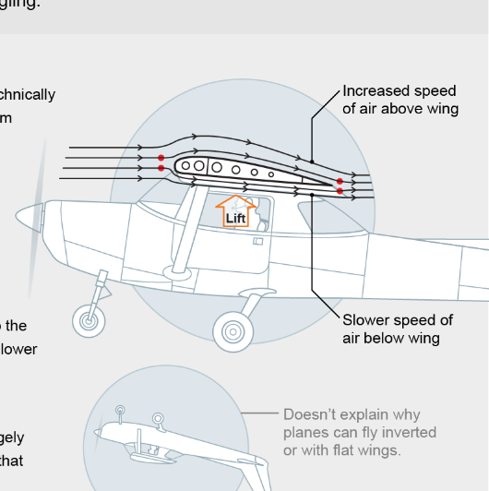
Bernoulli’s Principle
Bernoulli's Principle- the idea that a molecule is split into elements resulting in them wanting to get back together at the end is FALSE
Notes:
Maya
maya

Slide 7
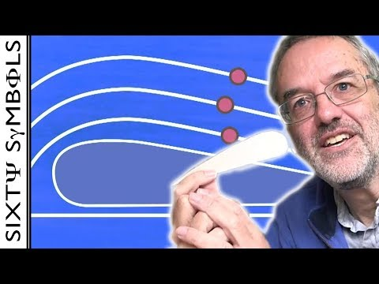
Why False?
Notes:
maya

Slide 8
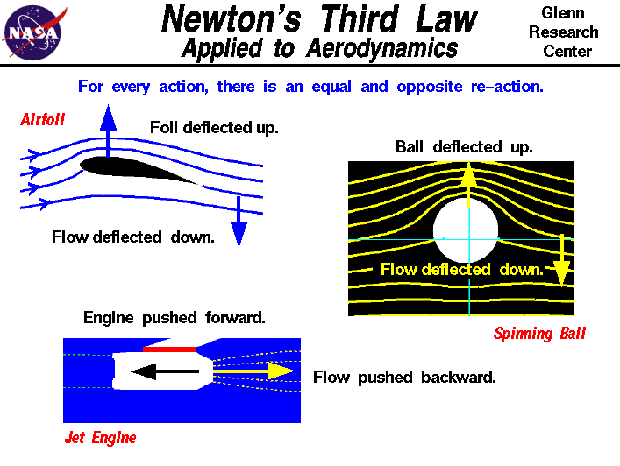
Newton + False lift theory
Newton’s 3rd law — air that goes under the wing is pushed down, which pushes the wing up, generating lift
Notes:
harish

Slide 9
Visualization
Notes:
harish

Slide 10
Why Wrong?
Blow against your hand. Where does the air go?
Air itself has its own velocities that are all different from the others (that’s really what pressure is), so it can’t be simply predicted as if it were “bouncing” off
Notes:
maya

Slide 11
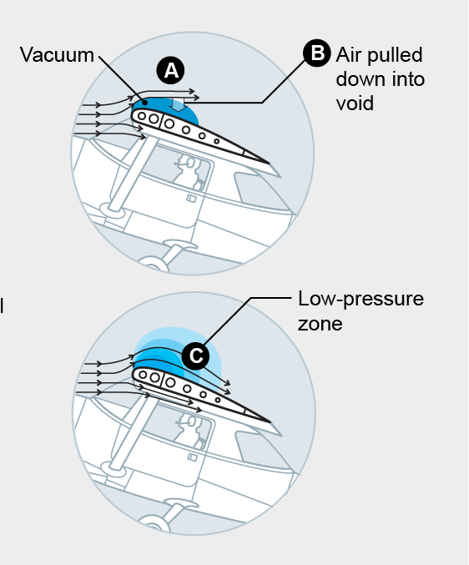
Possibility
The idea: an increase in velocity of a fluid results in a decrease of pressure
Possibility: Air above the wing A) momentarily flows backwards B) vacuum fills the void C) but not all of it - creating a low -pressure zone
Notes:
maya

Slide 12
Also Possibility:
Same idea: an increase in velocity of a fluid results in a decrease of pressure
Combination of Bernoulli Effect + Newton’s Ideas
Notes:
agastya

Slide 13
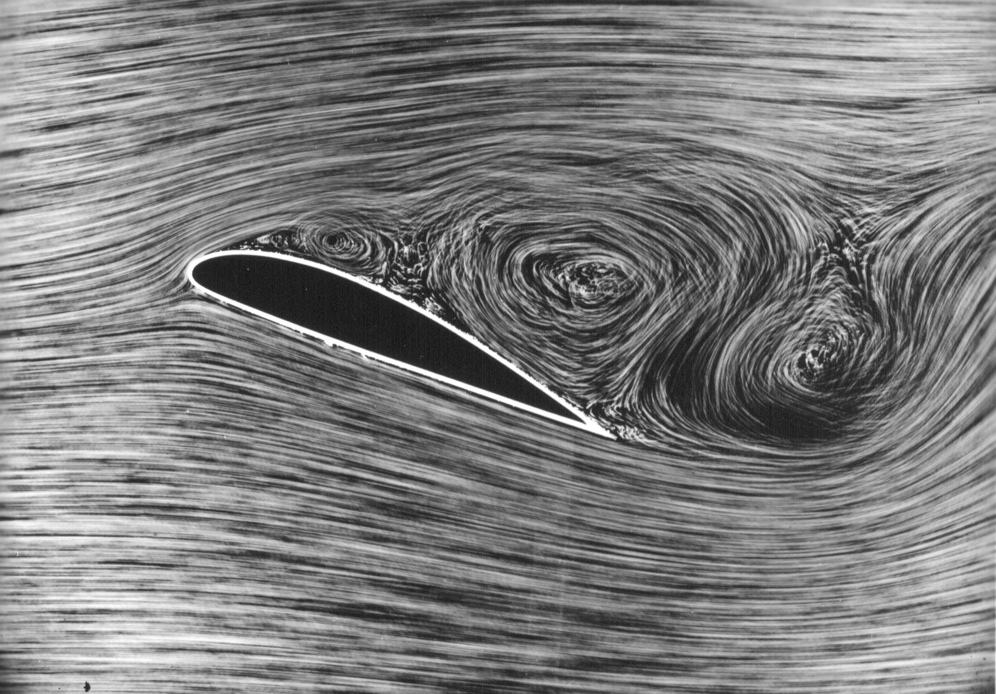
Synthesis:
no one knows,
but we have accurate equations!
Notes:
harish

Slide 14
Further Definitions

Slide 15
Warm Up:
Yes, we tried to get through this last time but ran out of time
Spend 3 mins researching one of these and explain it to the rest of the breakout group
Chord line
Camber line
Leading edge
Trailing edge
Wing span
Notes:
Agastya

Slide 16
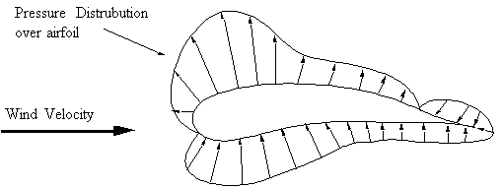
Center of Lift
A vertical line on the graph that creates an equal area on the right and left
Annotate where you think the line is!
Notes:
agastya

Slide 17
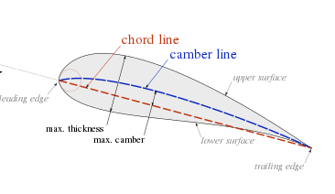
It’s actually at quarter chord
Chord: the line from front tip to back tip of an airfoil
Notes:
harish

Slide 18
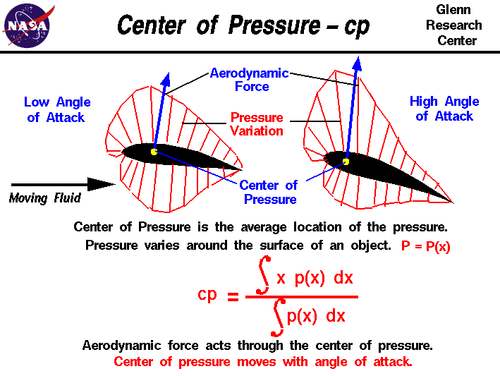
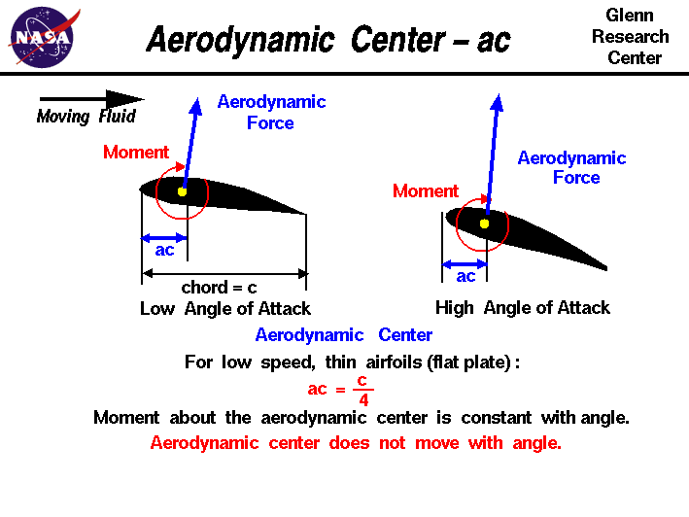
Center of Lift
Basically: Quarter Chord
A lift vector can be placed at QC
a way to summarize the lift generated by the wing at one point (makes lift a lot easier).
Notes:
Harish

Slide 19
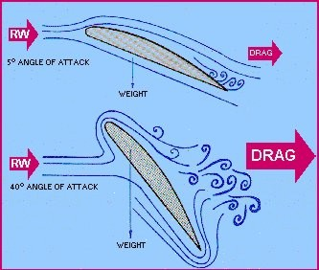
Angle of Attack (AOA)
The angle of attack is basically how much the wings are pointing up or down
The angle of attack is critical in generating lift, but while doing so, also increases drag.
Notes:
agastya

Slide 20
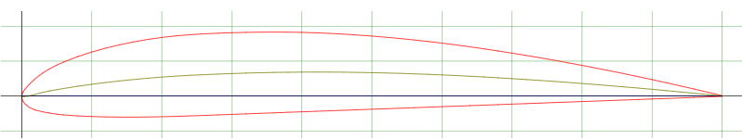
Which one is the chord line?
The red line
The green line
Along the x axis
Notes:
Harish - c

Slide 21
What is the angle of attack of this airfoil?
How is drag effected?
Notes:
Maya - 0, least amount of drag

Slide 22
Where is the center of lift if my chord is 4 ft?
1 ft into the wing
2 ft into perimeter of the camber line
At the center of pressure
The trailing edge
Notes:
Agastya - a,c

Slide 23
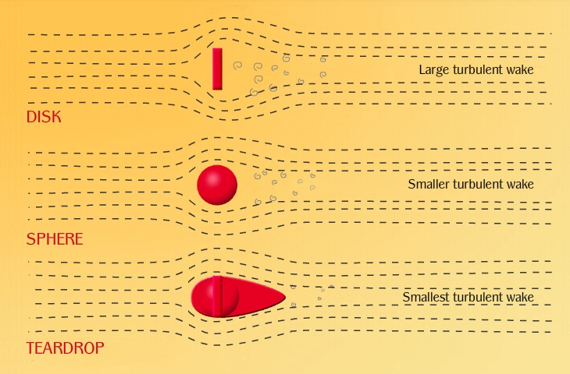
Drag
Notes:
harish

Slide 24
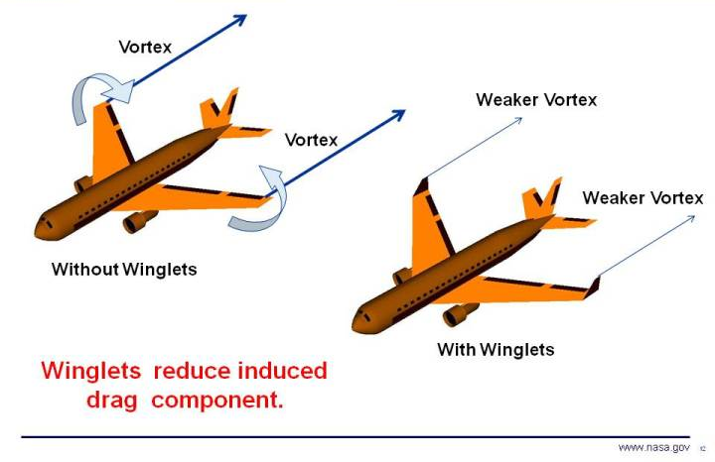
Induced Drag
Low Pressure top
High Pressure Bottom
Air wants to fill the space, moves to the top → Drag
Notes:
harish

Slide 25
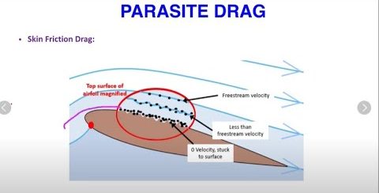
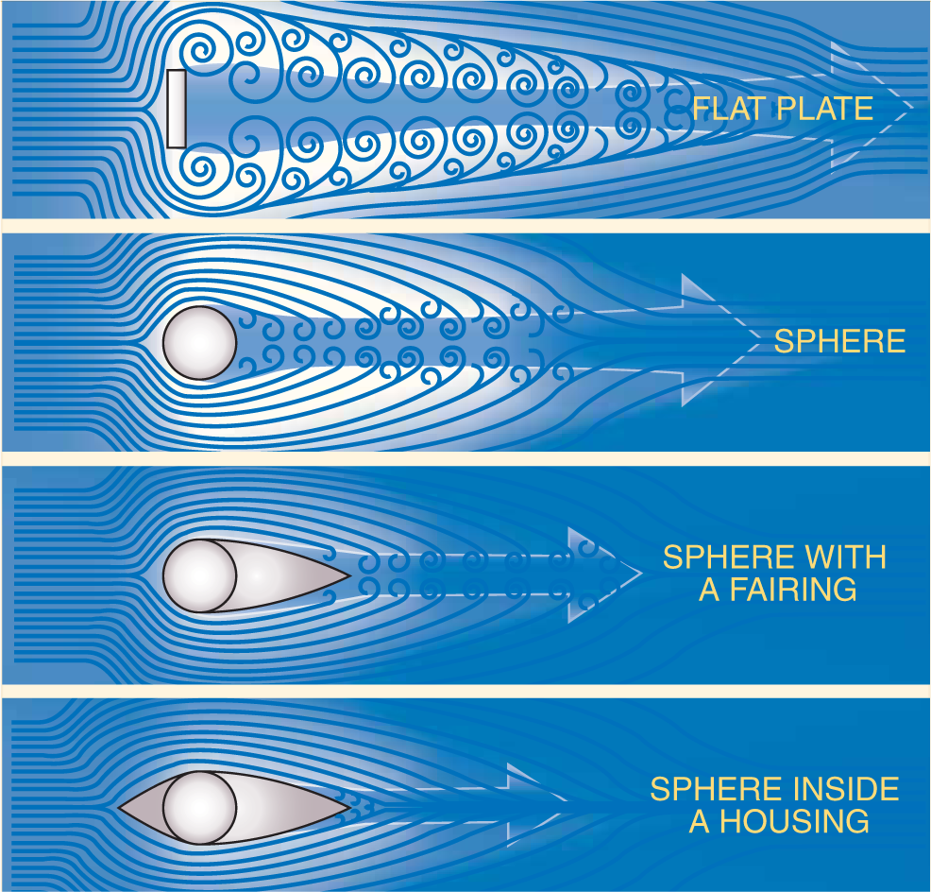
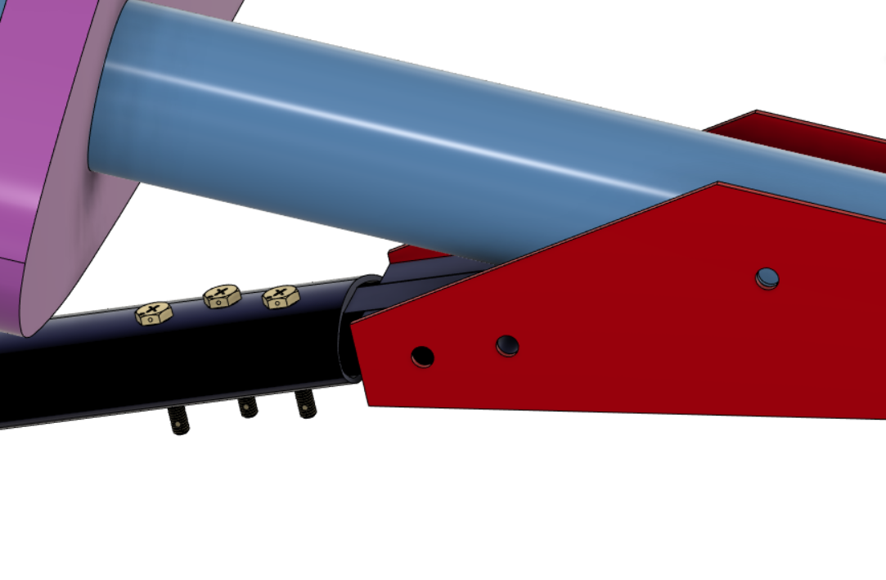
Parasitic Drag - function of design
Function of Design
Notes:
Maya - share fusion

Slide 26
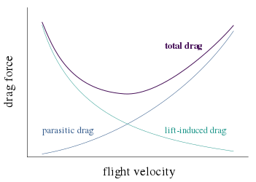
Let’s Take this Apart
Notes:
agastya

Slide 27
How is induced drag created?
Notes:
Harish - Higher pressure bottom, lower pressure top, wants to fill in the gaps

Slide 28
How does speed affect induced drag?
Notes:
Maya - Answer - higher the speed, lower the induced drag

Slide 29
What type of drag can we control with design?
Notes:
Agastya- Parasitic drag

Slide 30
Airfoils

Slide 31
Airfoils
Lift
the side view of a wing
produces lift and drag
remember, lift is an upward force and drag slows the wing down, backwards force
There are lots of different airfoil shapes, each has different uses/benefits
Drag
Notes:
harish

Slide 32
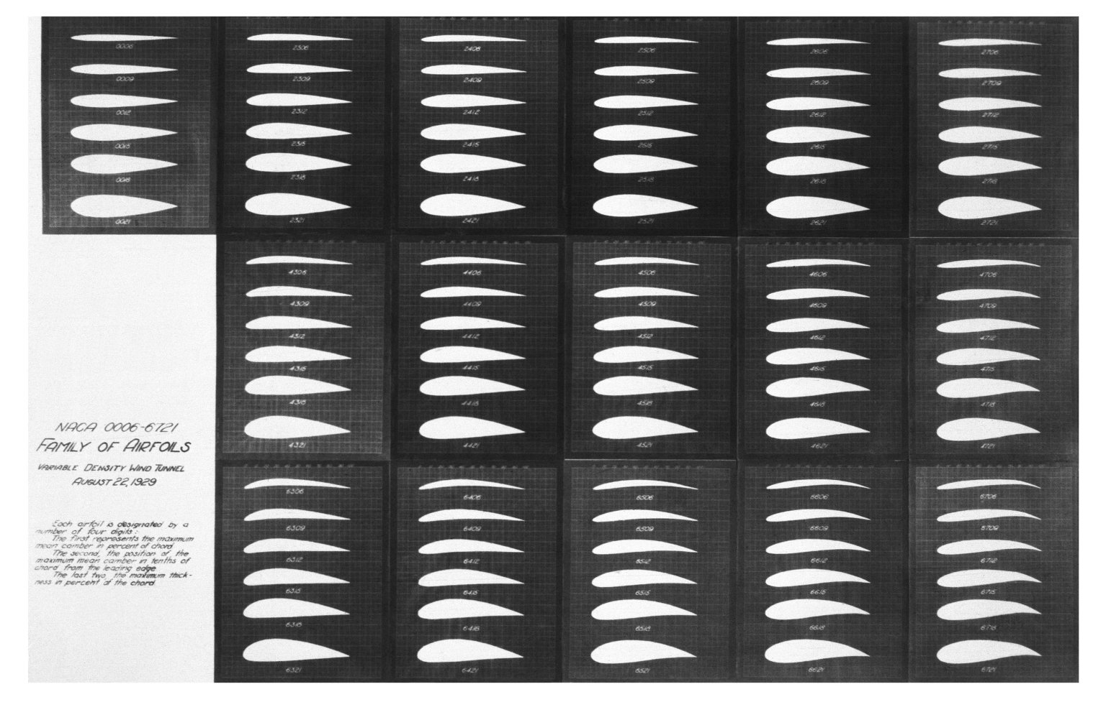
Notes:
harish

Slide 33
Activity
In Groups: compare and contrast Clark Y and one other airfoil → 15 minutes!
Clark Y
NACA 4418
NACA 4415
NACA 0015
Notes:
maya

Slide 34
Define
Lift Coefficient’s (Cl) relationship to lift
Drag Coefficient’s (Cd) relationship to drag
Reynold’s Number
Notes:
maya

Slide 35
Per Airfoil
Choose a Reynold’s Number
At what Angle of Attack (alpha) is there the lowest Drag?
At what Angle of Attack (alpha) is there the highest Lift?
What Alpha will maximize Lift/Drag
What does this mean?
Compare
Notes:
maya

Slide 36
Presentation Time!

Slide 37
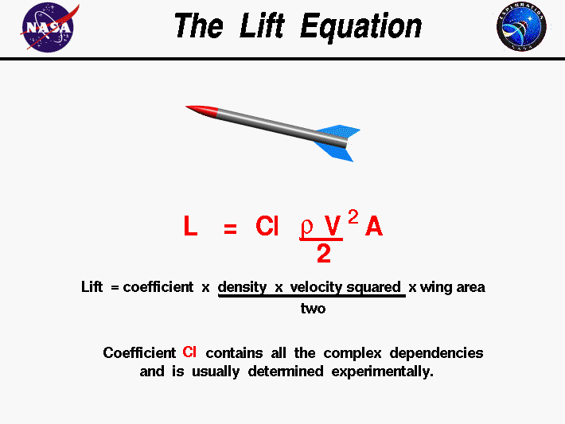
Lift Coefficient
Notes:
agastya

Slide 38
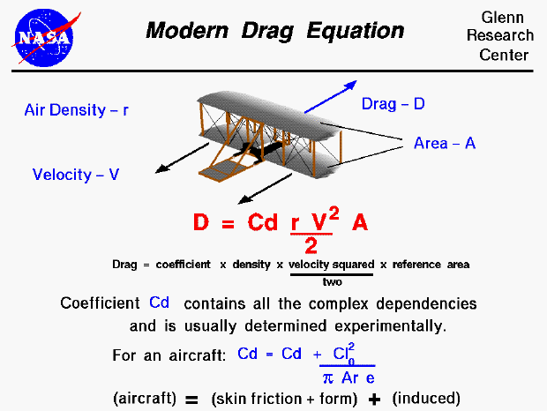
Drag Coefficient
Notes:
harish

Slide 39
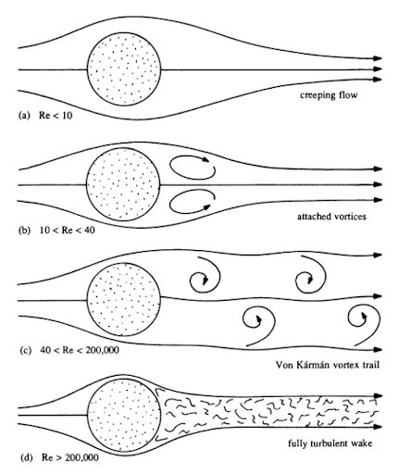
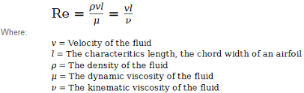
Reynold’s Number
How “flow-y” the air is
Definition: viscosity
How thick something is
lower, think water → you can swish that around easy
higher, think honey → not easily displaced
Notes:
maya

